Slide 1
CI/CD for NodeJS App in AWS
Artem Kepets, DOS15-onl / DevOps

Slide 2
Introduction
This thesis project aims to demonstrate the seamless assembly and deployment of a React + NodeJS application interacting with MongoDB. Leveraging Terraform on AWS, a network infrastructure was configured, comprising three EC2 instances designated for Jenkins Master and Agent, the product server. Additionally, Security Groups were established to secure the instances. The project includes the development of the Jenkins Pipeline, which includes the process of testing the application, building docker images, publishing them in the ECR and deploying the application to the production server.

Slide 3
Project Objectives
Build Process: Implement an efficient build process for the React + NodeJS application.
AWS Infrastructure: Utilize Terraform to set up a network infrastructure on AWS, including the creation of EC2 instances for Jenkins Master and Agent, the product server.
Security Measures: Configure Security Groups to ensure the secure operation of the Jenkins instances and product instances.
Pipeline Automation: Develop a Jenkins Pipeline to automate the testing, build and deployment processes.
Deployment: Deploy the application into a product instqance for testing and validation.

Slide 4
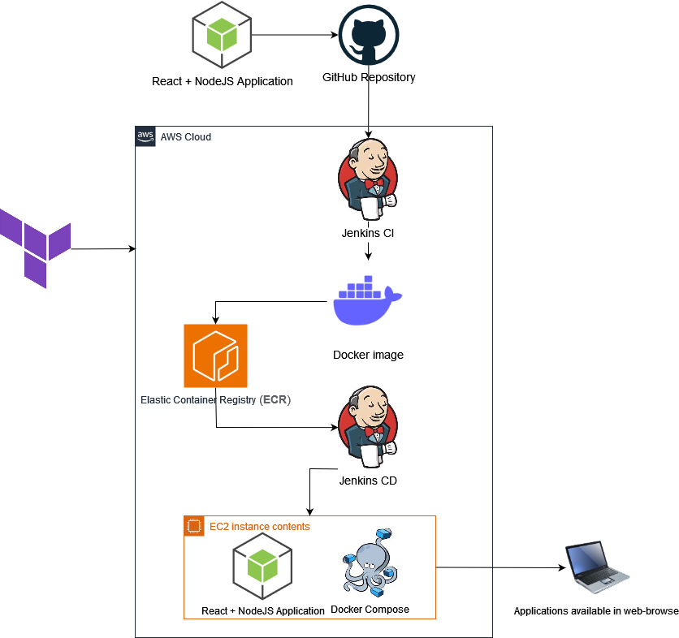

Slide 5
Technologies Used
Frontend: React
Backend: NodeJS
Database: MongoDB
Infrastructure as Code (IaC): Terraform
Continuous Integration/Continuous Deployment (CI/CD): Jenkins
Container Orchestration: Docker Compose
Cloud Provider: Amazon Web Services (AWS)

Slide 6
Project Structure
1. AWS Infrastructure Setup
Network configuration with Terraform.
Creation of EC2 instances for Jenkins Master and Jenkins Agent.
Security Groups for secure communication.
2. Jenkins Pipeline
Automated build and deployment processes.
3. React + NodeJS Application
Frontend developed in React.
Backend powered by NodeJS.
Interaction with a MongoDB database.
4. Deployment
Application deployment into product instance AWS.

Slide 7
module "network" {
source = "./modules/network"
vpc_name = "dos-15-kepets-vpc"
vpc_cidr = "10.0.0.0/16"
availability_zones = ["us-east-1a"]
public_subnet_cidrs = ["10.0.1.0/24"]
private_subnet_cidrs = ["10.0.2.0/24"]
enable_dns_hostnames = true
enable_dns_support = true
}
module "jenkins_master_sg" {
source = "./modules/security"
name = "dos_15_kepets_jenkins_master_sg"
description = "Security Group for Jenkins Master."
vpc_id = module.network.vpc_id
ingress_ports = [
{ from_port = 57385, to_port = 57385 },
{ from_port = 57386, to_port = 57386 }
]
ingress_protocol = "tcp"
ingress_cidr_blocks = ["0.0.0.0/0"]
egress_from_port = 0
egress_to_port = 0
egress_protocol = "-1"
egress_cidr_blocks = ["0.0.0.0/0"]
}
module "jenkins_slave_sg" {
source = "./modules/security"
name = "dos_15_kepets_jenkins_slave_sg"
description = "Security Group for Jenkins Slave."
vpc_id = module.network.vpc_id
ingress_ports = [
{ from_port = 57387, to_port = 57387 },
{ from_port = 57388, to_port = 57388 }
]
ingress_protocol = "tcp"
ingress_cidr_blocks = ["0.0.0.0/0"]
egress_from_port = 0
egress_to_port = 0
egress_protocol = "-1"
egress_cidr_blocks = ["0.0.0.0/0"]
}
module "prod_sg" {
source = "./modules/security"
name = "dos_15_kepets_ec2_prod_sg"
description = "Security Group for prod stage."
vpc_id = module.network.vpc_id
ingress_ports = [
{ from_port = 22, to_port = 22 },
{ from_port = 3000, to_port = 3000 } ]
ingress_protocol = "tcp"
ingress_cidr_blocks = ["0.0.0.0/0"]
egress_from_port = 0
egress_to_port = 0
egress_protocol = "-1"
egress_cidr_blocks = ["0.0.0.0/0"]
}
module "jenkins_master" {
source = "./modules/ec2"
name = "dos_15_kepets_jenkins_master"
instance_type = "t2.micro"
key_name = "DOS_15_kepets"
subnet_id = element(module.network.public_subnet_ids, 0)
security_group_id = module.jenkins_master_sg.security_group_id
volume_size = 8
volume_type = "gp2"
associate_public_ip_address = true
user_data = "${file("./modules/ec2/scripts/jenkins_install.sh")}"
}
module "jenkins_slave" {
source = "./modules/ec2"
name = "dos_15_kepets_jenkins_slave"
instance_type = "t2.micro"
key_name = "DOS_15_kepets"
subnet_id = element(module.network.public_subnet_ids, 0)
security_group_id = module.jenkins_slave_sg.security_group_id
volume_size = 8
volume_type = "gp2"
associate_public_ip_address = true
user_data = <<-EOF
#!/bin/bash
sudo sed -i 's/#Port\s22/Port 57387/' /etc/ssh/sshd_config || exit 1
sudo systemctl restart sshd.service || exit 1
sleep 5
sudo yum update -y || exit 1
sudo yum install java-17-amazon-corretto -y || exit 1
EOF
}

Slide 8
module "prod_stage" {
source = "./modules/ec2"
name = "dos_15_kepets_prod_stage"
instance_type = "t2.micro"
key_name = "DOS_15_kepets"
subnet_id = element(module.network.public_subnet_ids, 0)
security_group_id = module.prod_sg.security_group_id
volume_size = 8
volume_type = "gp2"
associate_public_ip_address = true
user_data = <<-EOF
#!/bin/bash
sudo yum update -y || exit 1
sudo amazon-linux-extras install docker -y || exit 1
sudo service docker start || exit 1
sudo service docker status || exit 1
sudo groupadd docker || exit 1
sudo usermod -a -G docker ec2-user || exit 1
newgrp docker || exit 1
docker --version || exit 1
sudo curl -L https://github.com/docker/compose/releases/latest/download/docker-compose-$(uname -s)-$(uname -m) -o /usr/local/bin/docker-compose || exit 1
sudo chmod +x /usr/local/bin/docker-compose || exit 1
docker-compose version || exit 1
EOF
}
module "ecr_frontend" {
source = "./modules/ecr"
name = "frontend_dos_15_kepets"
image_tag_mutability = "IMMUTABLE"
scan_on_push = true
}
module "ecr_backend" {
source = "./modules/ecr"
name = "backend_dos_15_kepets"
image_tag_mutability = "IMMUTABLE"
scan_on_push = true
}

Slide 9
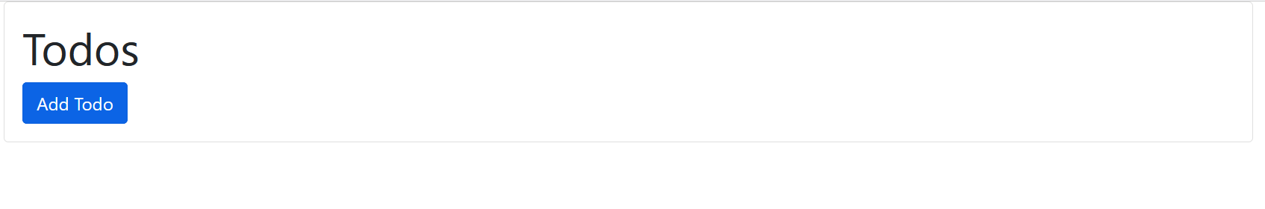
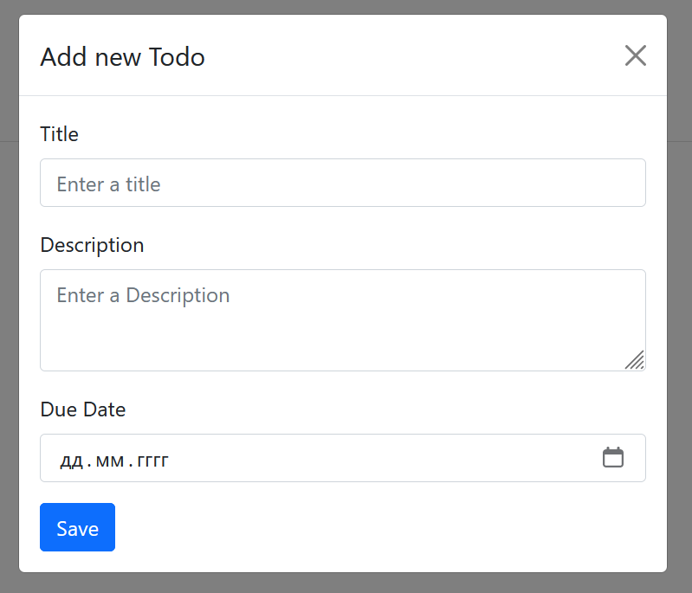
Application

Slide 10
CI/CD Pipeline Stages Overview
Checkout
Objective: Retrieve the project source code from the GitHub repository.
Testing the application
Objective: Conducting application health testing.
Build Docker Images
Objective: Create Docker images for the frontend, backend, and database components.
Push to ECR AWS
Objective: Formation of an artifact (docker image) and sending it to the ECR.
Deploy to AWS instance
Objective: Deploying the application to the production server.

Slide 11
pipeline {
agent {label 'node1' }
tools {nodejs 'node'}
parameters {
string(name: 'USERNAME_HOST', description: 'Username Host')
string(name: 'IP_HOST', description: 'Host IP')
string(name: 'TOKEN', description: 'Token telegram bot')
string(name: 'CHAT_ID', description: 'Chat id telegram bot')
string(name: 'AWS_ACCOUNT_ID', description: 'Account id AWS')
}
stages {
stage("Clone code") {
steps {
echo "Clone code from the GitHub repository"
git url: "https://github.com/DtVatson/TMS_Projects.git", branch: "main"
}
}
stage('Install dependencies') {
steps {
sh 'cd /home/ec2-user/workspace/Test_Nodejs/apps/backend && npm install'
}
}
stage('Test') {
steps {
sh 'cd /home/ec2-user/workspace/Test_Nodejs/apps/backend && npm test'
}
}
stage("Build") {
steps {
echo "Building Image"
sh "sudo docker build -t backend_dos_15_kepets ./apps/backend"
sh "sudo docker build -t frontend_dos_15_kepets ./apps/frontend"
}
}
stage("Push to ECR AWS") {
steps {
echo "Push build image to ECR AWS"
script{
sh """
curl -s -X POST https://api.telegram.org/bot${params.TOKEN}/sendMessage -d chat_id=${params.CHAT_ID} -d parse_mode="HTML" -d text="<b>Project</b> : POC \
<b>Build image</b> : OK "
"""
}
input "Pushing Docker images to ECR AWS?"
echo 'Pushing Docker images to ECR AWS...'
sh "aws ecr get-login-password --region us-east-1 | docker login --username AWS --password-stdin ${params.AWS_ACCOUNT_ID}.dkr.ecr.us-east-1.amazonaws.com"
sh "docker tag backend_dos_15_kepets:latest ${params.AWS_ACCOUNT_ID}.dkr.ecr.us-east-1.amazonaws.com/backend_dos_15_kepets:latest"
sh "docker tag frontend_dos_15_kepets:latest ${params.AWS_ACCOUNT_ID}.dkr.ecr.us-east-1.amazonaws.com/frontend_dos_15_kepets:latest"
sh "docker push ${params.AWS_ACCOUNT_ID}.dkr.ecr.us-east-1.amazonaws.com/backend_dos_15_kepets:latest"
sh "docker push ${params.AWS_ACCOUNT_ID}.dkr.ecr.us-east-1.amazonaws.com/frontend_dos_15_kepets:latest"
}
}

Slide 12
stage("Deploy") {
steps {
script{
sh """
curl -s -X POST https://api.telegram.org/bot${params.TOKEN}/sendMessage -d chat_id=${params.CHAT_ID} -d parse_mode="HTML" -d text="<b>Project</b> : POC \
<b>Ready to deploy</b> : OK "
"""
}
input "Install new version on prod?"
sshagent (credentials: ['prod_stage']) {
sh "ssh -o StrictHostKeyChecking=no ${params.USERNAME_HOST}@${params.IP_HOST} rm -rf TMS_Projects"
sh "ssh -o StrictHostKeyChecking=no ${params.USERNAME_HOST}@${params.IP_HOST} git clone https://github.com/DtVatson/TMS_Projects.git"
sh "ssh -o StrictHostKeyChecking=no ${params.USERNAME_HOST}@${params.IP_HOST} aws ecr get-login-password --region us-east-1 | docker login --username AWS --password-stdin ${params.AWS_ACCOUNT_ID}.dkr.ecr.us-east-1.amazonaws.com"
sh "ssh -o StrictHostKeyChecking=no ${params.USERNAME_HOST}@${params.IP_HOST} docker pull ${params.AWS_ACCOUNT_ID}.dkr.ecr.us-east-1.amazonaws.com/backend_dos_15_kepets:latest"
sh "ssh -o StrictHostKeyChecking=no ${params.USERNAME_HOST}@${params.IP_HOST} docker pull ${params.AWS_ACCOUNT_ID}.dkr.ecr.us-east-1.amazonaws.com/frontend_dos_15_kepets:latest"
sh "ssh -o StrictHostKeyChecking=no ${params.USERNAME_HOST}@${params.IP_HOST} docker-compose -f /home/ec2-user/TMS_Projects/apps/docker-compose.yml stop"
sh "ssh -o StrictHostKeyChecking=no ${params.USERNAME_HOST}@${params.IP_HOST} docker-compose -f /home/ec2-user/TMS_Projects/apps/docker-compose.yml up -d"
}
}
}

Slide 13
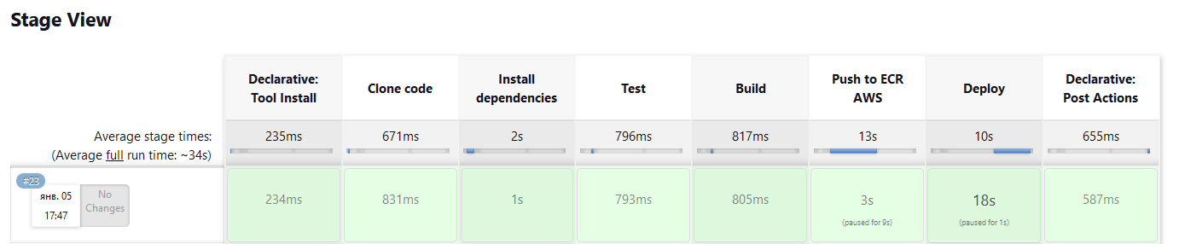
CI/CD Pipeline Stage View

Slide 14
Conclusion
This project showcases the integration of various technologies to achieve a streamlined CI/CD process for a React + NodeJS application. The use of Terraform, Jenkins, and Docker illustrates a robust approach to infrastructure management and application deployment.

